Slide 1
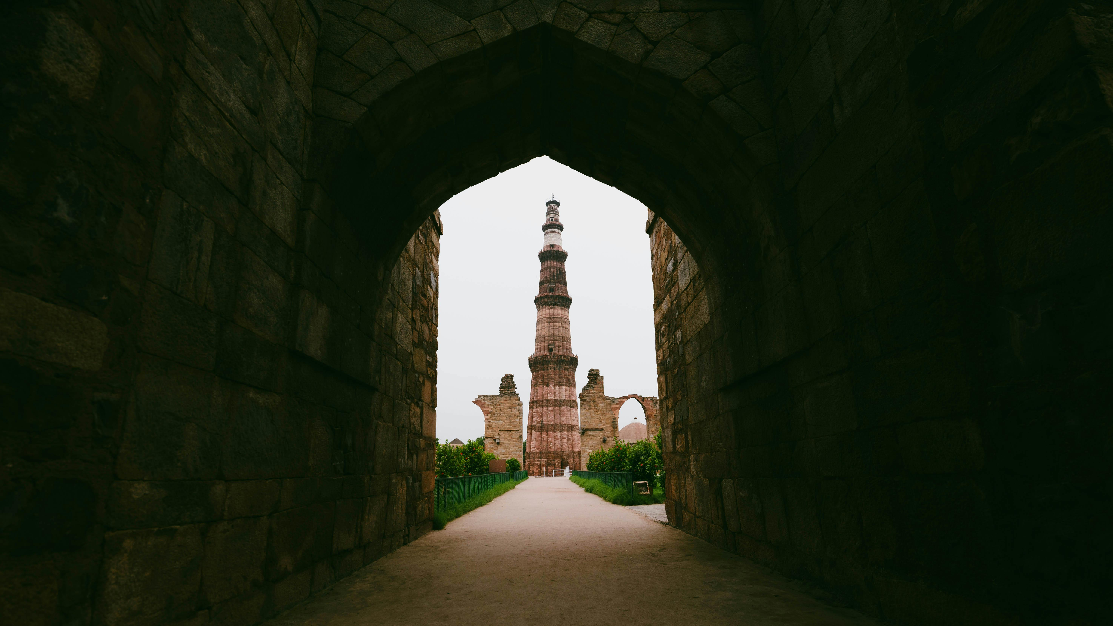
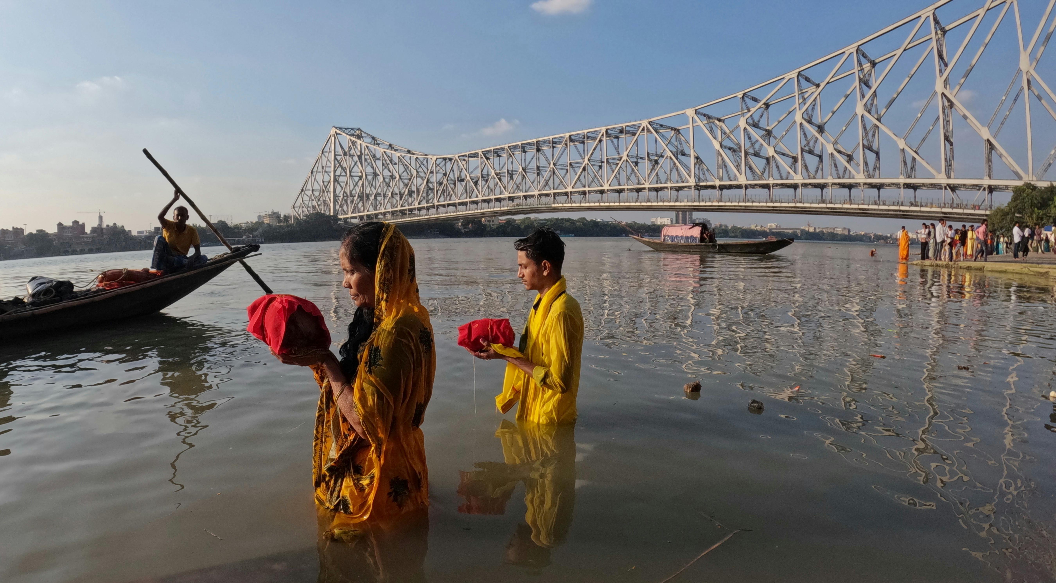
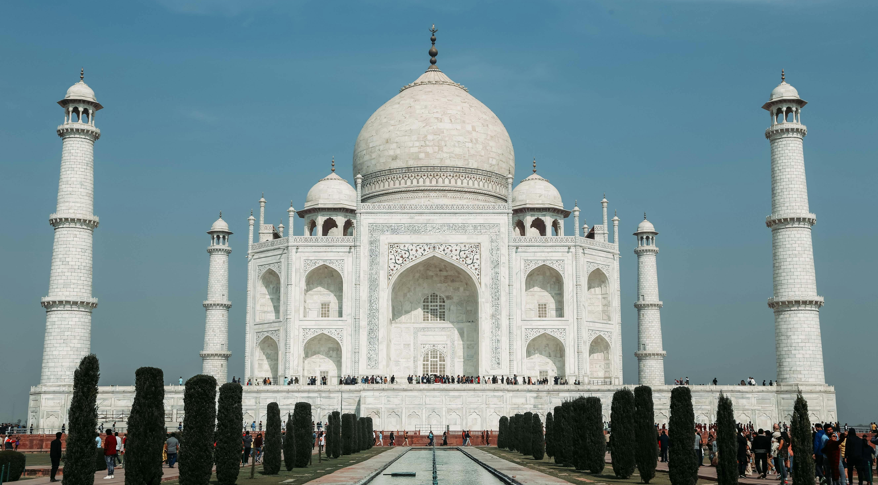
Delhi
Delhi, officially known as the National Capital Territory (NCT) of Delhi, is the heart of India. It serves as the centre of politics, culture, and history. New Delhi, the capital of India, lies within Delhi and is the seat of all three branches of the Government of India. The city is famous for its rich history, magnificent monuments like the Red Fort, India Gate, and Qutub Minar.
Delhi, India's capital, is a city rich in heritage, and one of its most iconic landmarks is the Qutub Minar. Standing at 73 meters, this UNESCO World Heritage Site is the tallest brick minaret in the world.

Slide 2
Kolkata
Delhi, officially known as the National Capital Territory (NCT) of Delhi, is the heart of India. It serves as the centre of politics, culture, and history. New Delhi, the capital of India, lies within Delhi and is the seat of all three branches of the Government of India. The city is famous for its rich history, magnificent monuments like the Red Fort, India Gate, and Qutub Minar.
Kolkata, often called the "City of Joy," is known for its culture, colonial charm, and iconic landmarks — none more famous than the Howrah Bridge. Spanning the Hooghly River.

Slide 3
DELHI
Agra
Delhi, officially known as the National Capital Territory (NCT) of Delhi, is the heart of India. It serves as the centre of politics, culture, and history. New Delhi, the capital of India, lies within Delhi and is the seat of all three branches of the Government of India. The city is famous for its rich history, magnificent monuments like the Red Fort, India Gate, and Qutub Minar.
Agra, a historic city on the banks of the Yamuna River in Uttar Pradesh, is world-renowned for the stunning Taj Mahal — one of the Seven Wonders of the World.

